Slide 1


Linux for HPC
https://hpcleuven.github.io/Linux-for-HPC/

Slide 2
Overview
Who is this course for? - You know Linux basics - You use HPC platforms - Need a generic overview of Linux tools
Outline
Using OnDemand desktop app
More Linux commands
Key Concepts, Redirection & Pipes
Shell, Bash and Job Scripts
Installing & Compiling Code

Slide 3

Open OnDemand
Open Source General purpose HPC Portal
Open source software project
Installable/designed for HPC clusters
Platform that can be extended with additional/customized apps
No client software necessary, only browser is needed

Slide 4
Open OnDemand links
Project: https://www.openondemand.org/
KU Leuven portal: https://ondemand.hpc.kuleuven.be/
Documentation: https://docs.vscentrum.be/compute/portal/ondemand/index.html
Desktop app https://docs.vscentrum.be/compute/portal/ondemand/desktop.html

Slide 5
Open OnDemand Desktop app
Useful for support:
Once the Desktop app is active, you can grant view-only access to other VSC users.
In the ‘My Interactive Sessions’ menu, right-click the ‘View Only (Share-able Link)’ button to copy the link and share it with others. Any VSC user with the link can view your Desktop session in real-time, which is especially helpful for job troubleshooting and hands-on training.
By clicking in the "Session ID" you have access to logs, and that it can be useful to refer to these in case the user needs support.

Slide 6
Open OnDemand Desktop app
Best practices (browsers):
In Chromium-based browsers such as Google Chrome and Microsoft Edge, the clipboard in the Desktop app will have the same content as your device, meaning that you can copy-paste text to and from the Desktop as expected.
Other browsers, like Firefox and Safari, do not currently support this and in that case you will need to transfer text through the clipboard in the panel on the left hand side.

Slide 7
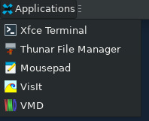
Open OnDemand Desktop app
Minimalistic container:
Due to security concerns some functionality is deliberately absent:
Slurm-related commands,
Browser
Some extra small tools (myquota, apptainer, xarchiver – may be added in the future)
For the existing application app we advise to use that one
Other frequently used apps added (VMD, VisIt)
Editing can be done in a OOD editor or in Mousepad
ImageViewer – display command (part of Imagemagick module) or via OOD file explorer
All the other apps can be accessed from the terminal with loading the module(s)
Desktop app can use all the resources of the compute node for GUI applications (vs. login node limits only)

Slide 8
Open OnDemand Desktop app tunnel
Using local browser
Certain applications expect usage of the browser (JupyterLab, Streamlit, CryoSparc)
Instead of built-in browser a local browser should be used (with the tunnel setup)
ssh -L 11111:r1i3n5:44444 -N <vsc-account>@<vsc-loginnode>
https://docs.vscentrum.be/compute/terminal/openssh_ssh_tunnel.html#
local port
remote host (compute node)
server port

Slide 9
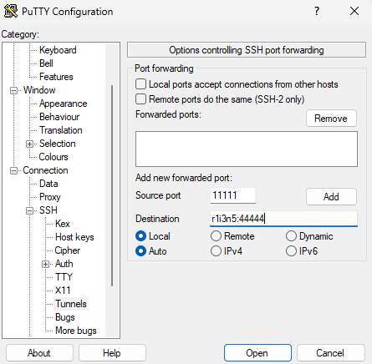
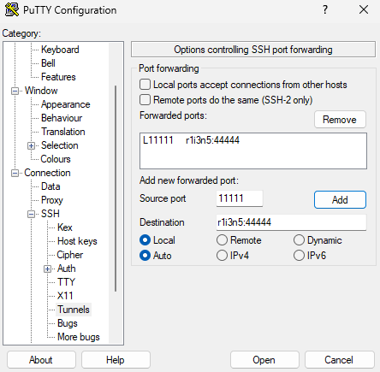
Open OnDemand Desktop app tunnel
Using local browser https://docs.vscentrum.be/compute/terminal/putty_ssh_tunnel.html

Slide 10
Open OnDemand Desktop app tunnel
Using local browser
Other type of applications produce static HTML files (LinaroForge)
Files can be transferred to the local device
Local HTTP server can be started with the SSH tunnel (e.g. with Python http module, Python>=3.5)
/usr/bin/python3 -m http.server -b localhost <port>
* We have SSH Tunnel app coming soon. Follow the docs page for more details.

Slide 11
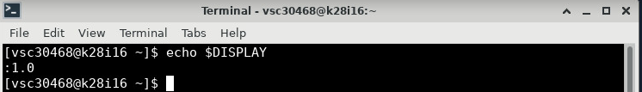
Open OnDemand Desktop app
Improved graphics performance
select wICE cluster interactive partition with GPU
open a terminal window
check display number ($ echo $DISPLAY)
Load the desired (visualization) module
Launch the executable with vglrun to enable hardware acceleration:
vglrun –d :<display> <executable>
vglrun -d :"${DISPLAY:1:-2}" <executable>

Slide 12
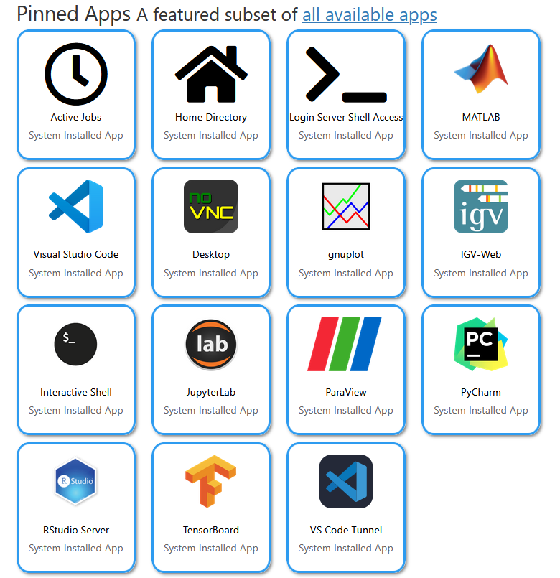
Open OnDemand Desktop app
Bash kernel can also be installed (used) within the JupyterLab

Slide 13
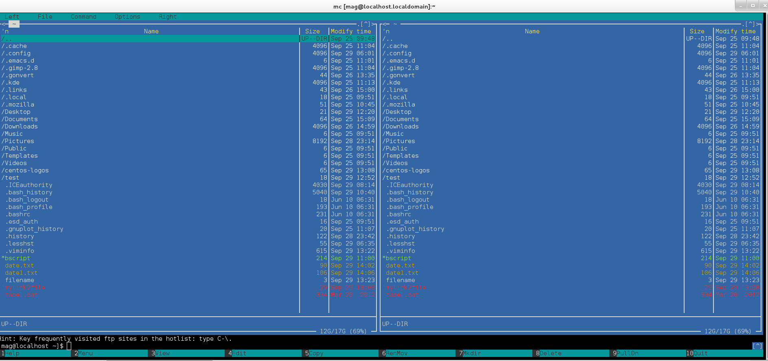
Linux shell
Shell interprets the command and request service from kernel
Similar to DOS but DOS has only one set of interface while Linux can select different shell
Bourne Again shell (Bash), TC shell (Tcsh), Z shell (Zsh)
Different shell has similar but different functionality
Bash is the default for Linux
Graphical user interface of Linux is in fact an application program work on the shell
Special (visual) type of shell is mc (midnight commander) – easy to process files
whoami
ls
pwd
Bash, Tcsh, Zsh
Kernel

Slide 14
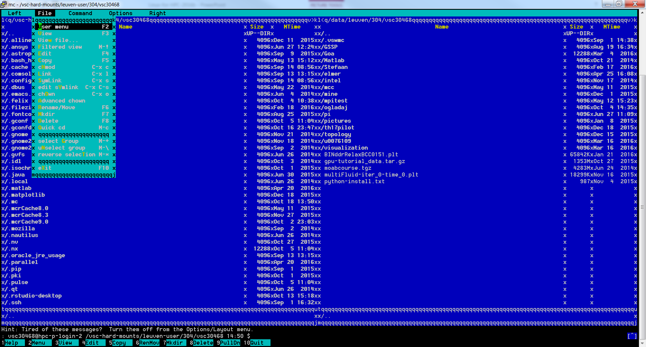
Midnight commander

Slide 15
Midnight commander
Keyboard Shortcuts
In normal browsing mode:
F1 - help. More readable than the 2000-line man page, although difficult to browse.
F2 - user menu ( offers option to gzip files, etc.)
F3 - view (handy to check the contents of an rpm or tgz file, or read contents of files)
F4 - edit with internal editor, mcedit
F5 - copy
F6 - rename or move
F7 - create a directory
F8 - delete
F9 - pull-down - accesses the menu bar at the top.
F10 - quit. Closes mc, as well as mcedit and any unwanted open menu.

Slide 16
Midnight commander
Selecting files
Insert (Ctrl + t alternatively) - select files (for example, for copying, moving or deleting).
+ - select files based on a pattern.
\ -unselect files based on a pattern.
* - reverse selection. If nothing was selected, all files will get selected.
Accessing the shell
There’s a shell awaiting your command at the bottom of the screen - just start typing (when no other command dialog is open, of course).
Since Tab is bound to switching panels (or moving the focus in dialogs), you have to use Esc Tab to use autocompletion. Hit it twice to get all the possible completions (just like in a shell). This works in dialogs too.
If you want inspect the output of the command, do some input or just prefer a bigger console, no need to quit mc. Just hit Ctrl + o - the effect will be similar to putting mc in the background. Your current working directory from mc will be passed on to the shell… and vice versa! Hit Ctrl + o again to return to mc.

Slide 17
Midnight commander
Panels
Alt + , - switch mc’s layout from left-right to top-bottom. Useful for operating on files with long names.
Alt + t - switch the panel’s listing mode in a loop: default, brief, long, user-defined. “long” is especially useful, because it maximizes one panel so that it takes full width of the window and longer filenames fit on screen.
Alt + i - synchronize the active panel with the other panel. That is, show the current directory in the other panel.
Ctrl + u - swap panels.
Alt + o - if the currently selected file is a directory, load that directory on the other panel and move the selection to the next file. If the currently selected file is not a directory, load the parent directory on the other panel and moves the selection to the next file. Ctrl + PgUp (or just left arrow, if you’ve enabled Lynx-like motion, see later) - move to the parent directory.
Alt + Shift + h - show the directory history. Might be easier to navigate than going back one entry at a time.
Alt + y - move to the previous directory in history.
Alt + u - move to the next directory in history.

Slide 18
Midnight commander
Searching files
Alt + ? - shows the full Find dialog.
Alt + s or Ctrl + s - quick search mode. Start typing and the selection will move to the first matching file. Press the shortcut again to jump to another match. Use wildcards (*, ?) for easier matching.
Common actions
Ctrl + Space - calculate the size of the selected directories. Press this shortcut when the selection is on .. to calculate the size of all the directories in the current directory.
Ctrl + x s (that is press Ctrl + x, let it go and then press s) - create a symbolic link (change s to l for a hardlink). I find it very useful and intuitive - the link will, of course, be created in the other panel. You can change it’s destination and name, like with any other file operation.
Ctrl + x c - open the chmod dialog.
Ctrl + x o - open the chown dialog.

Slide 19
Hands-on 1

Slide 20
VSC-related commands

Slide 21
Information about users and processes
who Lists all the users logged on the system.
$ whoami Tells what user I am logged as.
groups Tells which groups I belong to – important to check if already assigned to credits
top
Displays all processes (change with < or > for different parameters).
pstree
Displays process tree (pstree -u $USER).
tree
Lists contents of directories in a tree-like format
(tree $VSC_HOME).

Slide 22
Temporary storage
Temporary storage on the cluster nodes has a different location compared to regular Linux system.
$VSC_SCRATCH_NODE defines space that is available per node (to be used only during the job execution, need to copy the data as everything will be erased after the job ends).
Do not use /tmp directory on compute node (very limited space ~10GB, once exceeded the system and your job will crash).
Use $VSC_SCRATCH_NODE (/local_scratch) instead (~200GB)

Slide 23
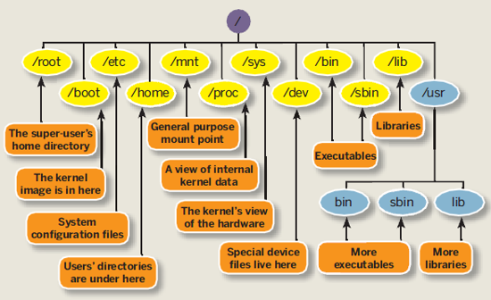
Linux File System
Source: http://linuxsuperuser07.blogspot.be/2011/09/rhel-6-file-system.html

Slide 24
Directory structure
Location of installed modules
Location of $VSC_HOME directories
Location of $VSC_DATA directories
/
Location of $VSC_SCRATCH directories
/boot
/dev
/proc
/local_scratch
/apps
/user
/data
/scratch
……..
……..
antwerpen
brussel
gent
leuven
antwerpen
brussel
gent
leuven
rocky8
rocky9
300
304
317
cascadelake
icelake
sapphirerapids
vsc30400
vsc30XXX
vsc30499
……..
2021a
2022b
2025a
……..

Slide 25
Directory structure
Location of installed modules
Location of $VSC_HOME directories
Location of $VSC_DATA directories
/
Location of $VSC_SCRATCH directories
/boot
/dev
/proc
/local_scratch
/apps
/user
/data
/scratch
……..
……..
antwerpen
brussel
gent
leuven
antwerpen
brussel
gent
leuven
rocky8
rocky9
300
304
317
cascadelake
icelake
sapphirerapids
vsc30400
vsc30XXX
vsc30499
2021a
2022b
2025a
……..
$VSC_HOME

Slide 26
Directory structure
Location of installed modules
Location of $VSC_HOME directories
Location of $VSC_DATA directories
/
Location of $VSC_SCRATCH directories
/boot
/dev
/proc
/local_scratch
/apps
/user
/data
/scratch
……..
……..
antwerpen
brussel
gent
leuven
antwerpen
brussel
gent
leuven
rocky8
rocky9
300
304
317
cascadelake
icelake
sapphirerapids
vsc30400
vsc30XXX
vsc30499
2021a
2022b
2025a
……..
$VSC_DATA

Slide 27
Directory structure
Location of installed modules
Location of $VSC_HOME directories
Location of $VSC_DATA directories
/
Location of $VSC_SCRATCH directories
/boot
/dev
/proc
/local_scratch
/apps
/user
/data
/scratch
……..
……..
antwerpen
brussel
gent
leuven
antwerpen
brussel
gent
leuven
rocky8
rocky9
300
304
317
cascadelake
icelake
sapphirerapids
vsc30400
vsc304XX
vsc30499
2021a
2022b
2025a
……..
$VSC_SCRATCH

Slide 28
Directory structure
Location of installed modules Genius
Path on Genius:
/apps/leuven/rocky8/skylake/2021a/software/Python/3.9.5-GCCcore-10.3.0
/
modules
logs
software
/boot
/dev
/proc
/local_scratch
/apps
/opt
GCC
matlab
Python
antwerpen
brussel
gent
leuven
3.9.5-GCCcore-10.3.0
3.10.8-GCCcore-10.3.0-bare
rocky8
bin
include
lib
cascadelake
icelake
skylake
cython
python
pip
2018a
2019b
2021a
Location of python (from 3.9.5-GCCcore-10.3.0)

Slide 29
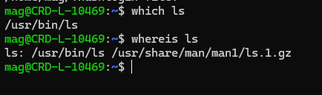
How to find location of the command
Before you run a command, which tells you where it is found $ which ls
which - shows the full path of (shell) commands
whereis - locate the binary, source, and manual page files for a command

Slide 30
Modules
You can add extra name or characters for searching available modules
Set the environment to use software packages:
$ module available or module av R
Lists all installed software packages
$ module av |& grep -i python
To show only the modules that have the string 'python' in their name, regardless of the case
$ module list
Lists all ‘loaded’ modules in current session
$ module load matlab/R2014a
Adds the ‘matlab’ command in your PATH
$ module load GCC
‘Load’ the (default) GCC version – not recommended (cannot be reproduced)
$ module unload R/3.1.2-foss-2014a-x11
Removes all only the selected module, other loaded modules – dependencies are still loaded
$ module purge
Removes all loaded modules from your environment

Slide 31
Modules
-i -> case insensitive
Works only for availibility, module load is always case sensitive
A few small tips for HPC intros regarding modules:
module -t av python | grep -i -e '^python'
• module -r av '^Python'
• module -r av '^Python.+foss.+’
The -t option forces terce output, i.e., something that is machine readable, and hence better to pipe through grep.
The -r option allows you to use regular expressions, e.g., ^Python means that the module name should start with Python, while ^Python.+foss means that the module name should start with Python and contain Foss as a substring.

Slide 32
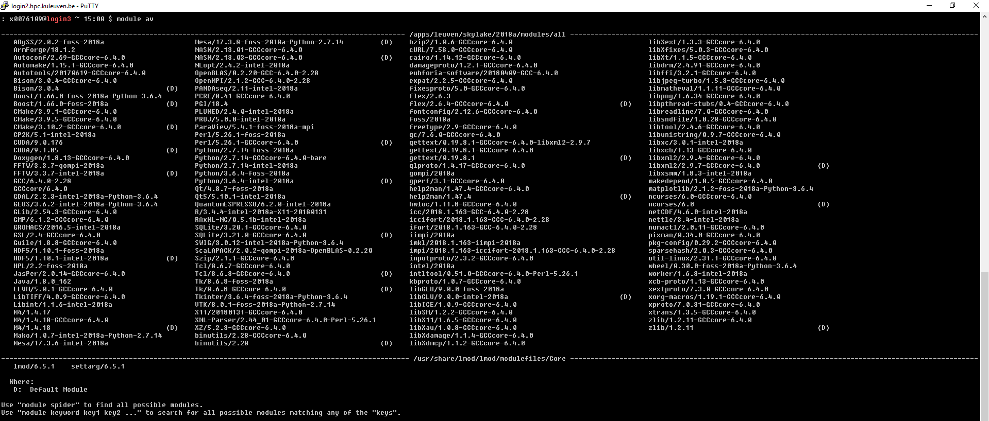
Modules
By default all the software is listed ($ module available)
The modules software manager is now Lmod. Lmod is a Lua based module system, but it is fully compatible with the TCL modulefiles we’ve used in the past. All the module commands that you are used to will work. But Lmod is somewhat faster and adds a few additional features on top of the old implementation.
To (re)compile – ask for interactive job
Default module at the time of loading. Subjest to changes.

Slide 33
Modules
$ module swap foss intel
= module unload foss; module load intel
$ module try-load packageXYZ
try to load a module with no error message if it does not exist
$ module keyword word1 word2 ...
Keyword searching tool, searches any help message or whatis description for the word(s) given on the command line
$ module help foss
Prints help message from modulefile
$ module spider foss
Describes the module

Slide 34
Modules
ml – convenient tool
$ ml
= module list
$ ml foss
=module load foss
$ ml -foss
=module unload foss (not purge!)
$ ml show foss
Info about the module
More info: http://lmod.readthedocs.io/en/latest/010_user.html
Possible to create user collections:
module save <collection-name>
module restore <collection-name>
module describe <collection-name>
module savelist
module disable <collection-name>

Slide 35
Find the right command
Executing the right command can be vital for your system. However in Linux there are so many different command lines that they are often hard to remember. So how do you search for the right command you need? The answer is apropos:
$ apropos ownership
chgrp (1) - change group ownership
chgrp (1p) - change the file group ownership
chown (1p) - change the file ownership
chown (2) - change ownership of a file
chown32 (2) - change ownership of a file
fchown (2) - change ownership of a file
fchown32 (2) - change ownership of a file
……

Slide 36
Monitoring the system:
free
Displays the status of RAM and VRAM
Mem: refers to RAM
Swap: refers to virtual RAM (the swap file)
Too little RAM will cause ‘thrashing’ (constantly moving information from RAM to VRAM)
top
Displayes all the tasks, but also available CPU and memory in the top bar
File /proc/cpuinfo (/proc/meminfo)
contains info about procesor/memory, no CPU usage
GPUs: nvidia-smi (watch “nvidia-smi”)

Slide 37
scp
The scp command allows you to copy files over ssh connections.
scp examplefile
touch test.txt
scp $HOME/test.txt vsc30XXX@login.hpc.kuleuven.be:$VSC_DATA/
Reconginzed only on the cluster, not on the remote host
Syntax similar to cp:
scp location-of-the-file-on-one-computer location-of-the-file-on-second-computer

Slide 38
scp
Own PC VSC cluster
File exists: /home/mag/test.txt
want to copy to the cluster into
$VSC_DATA
scp /home/mag/test.txt vsc30XXX@login.hpc.kuleuven.be:$VSC_DATA/
Reconginzed only on the cluster, not on the remote host
scp /home/mag/test.txt vsc30XXX@login.hpc.kuleuven.be:/data/leuven/304/vsc30XXX
Path to the file can be checked with e.g. echo $VSC_DATA on the cluster

Slide 39
rsync
rsync, which stands for remote sync, is a remote and local file synchronization tool. It uses an algorithm to minimize the amount of data copied by only moving the portions of files that have changed.
rsync options source destination
-v : verbose
-r : copies data recursively (but don’t preserve timestamps and permission while transferring data.
-a : archive mode, which allows copying files recursively and it also preserves symbolic links, file permissions, user & group ownerships, and timestamps.
-z : compress file data.
-h : human-readable, output numbers in a human-readable format.

Slide 40
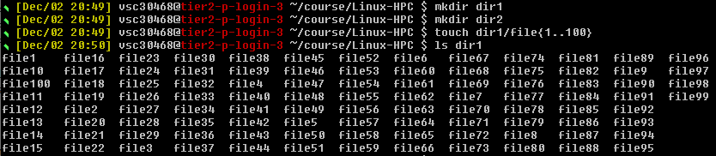
rsync
Let us prepare some files first
To sync the contents of dir1 to dir2 on the same system, you will run rsync and use the -r flag, which stands for “recursive” and is necessary for directory syncing:
$ rsync -r dir1/ dir2

Slide 41
rsync
Another option is to use the -a flag, which is a combination flag and stands for “archive”. This flag syncs recursively and preserves symbolic links, special and device files, modification times, groups, owners, and permissions. It’s more commonly used than -r and is the recommended flag to use.
Another tip is to double-check your arguments before executing an rsync command. Rsync provides a method for doing this by passing the -n or --dry-run options. The -v flag, which means “verbose”, is also necessary to get the appropriate output. We can combine the a, n, and v together.
$ rsync -anv dir1/ dir2
vs
$ rsync -anv dir1 dir2

Slide 42
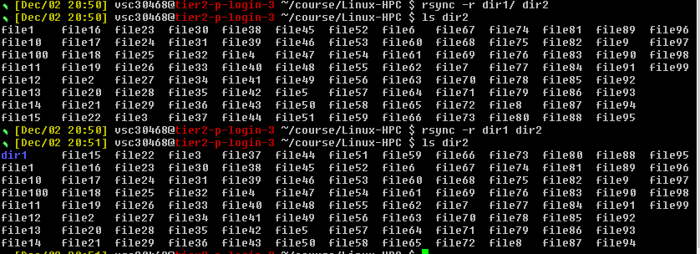
rsync
there is a trailing slash (/) at the end of the first argument in the
$ rsync -a dir1/ dir2
This trailing slash signifies the contents of dir1. Without the trailing slash, dir1, including the directory, would be placed within dir2. The outcome would create a hierarchy like the following: ~/dir2/dir1/[files]

Slide 43
rsync with remote system
To use rsync to sync with a remote system, we only need SSH access configured between your local and remote machines, as well as rsync installed on both systems. Having SSH access verified between the two machines, we can sync the dir1 folder from the previous section to a remote machine. In this case, that you want to transfer the actual directory, so we will omit the trailing slash:
$ rsync -a ~/dir1 vsc3XXXX@login.hpc.kuleuven.be:destination_directory

Slide 44
rsync with remote system
This process is called a push operation because it “pushes” a directory from the local system to a remote system. The opposite operation is pull, and is used to sync a remote directory to the local system. If the dir1 directory were on the remote system instead of your local system, the syntax would be the following:
$ rsync -a vsc3XXXX@login.hpc.kuleuven.be:/data/leuven/3XX/vsc3XXXX/dir1 place_to_sync_on_local_machine
Like cp and similar tools, the source is always the first argument, and the destination is always the second.

Slide 45
rsync extra flags
If you’re transferring files that have not already been compressed, like text files, you can reduce the network transfer by adding compression with the -z option:
$ rsync -az source destination
The -P flag is also helpful. It combines the flags --progress and --partial. This first flag provides a progress bar for the transfers, and the second flag allows to resume interrupted transfers:
$ rsync -azP source destination
If you run the command again, you’ll receive a shortened output since no changes have been made. This illustrates rsync’s ability to use modification times to determine if changes have been made:

Slide 46
rsync extra flags
In order to keep two directories truly in sync, it’s necessary to delete files from the destination directory if they are removed from the source. By default, rsync does not delete anything from the destination directory.
You can change this behavior with the --delete option. Before using this option, you can use -n, the --dry-run option, to perform a test to prevent unwanted data loss:
$ rsync -an --delete source destination

Slide 47
rsync extra flags
If you prefer to exclude certain files or directories located inside a directory you are syncing, you can do so by specifying them in a comma-separated list following the --exclude= option:
$ rsync -a --exclude=pattern_to_exclude source destination
If you have a specified pattern to exclude, you can override that exclusion for files that match a different pattern by using the --include= option:
$ rsync -a --exclude=pattern_to_exclude --include=pattern_to_include source destination

Slide 48
rsync extra flags
Finally, rsync’s --backup option can be used to store backups of important files. It’s used in conjunction with the --backup-dir option, which specifies the directory where the backup files should be stored:
$ rsync -a --delete --backup --backup-dir=/path/to/backups /path/to/source destination

Slide 49
Searching
A large majority of activity on UNIX systems involve searching for files and information.
find – utility to find files
find $VSC_HOME -name "test9*"
searches for files with name starting with test9 in $VSC_HOME directory
grep – great utility, searches for patterns inside files and will return the line, if found
grep -H -R test9 $VSC_HOME
searches for files with test9 in their text in $VSC_HOME directory

Slide 50
Keeping track of users
Simply typing <w> from the root account will provide a list of all users logged onto the system.
It will tell you:
their login date or time
their CPU usage
their last command
Use the finger command to learn anyone’s default shell
With last command we can watch user’s activity in the system. It will display complete user’s info like terminal, time, date, system reboot or boot and kernel version

Slide 51
The Shell revisited: features

Slide 52
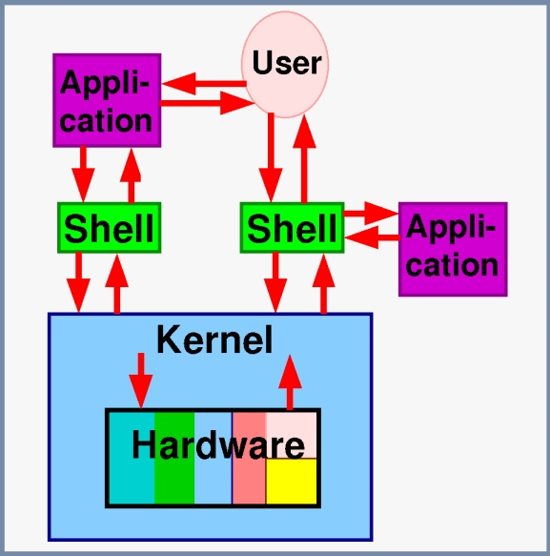
The shell
Not just an interface to the computer, also a scripting language – allows automation of tasks
Shells can be scripted: provide all the resources to write complex programs (variables, conditionals, iterations...)
Upon startup, shell executes commands found in the ~/.*rc file, allowing users to customize their shell.
Source: opensuse.org

Slide 53
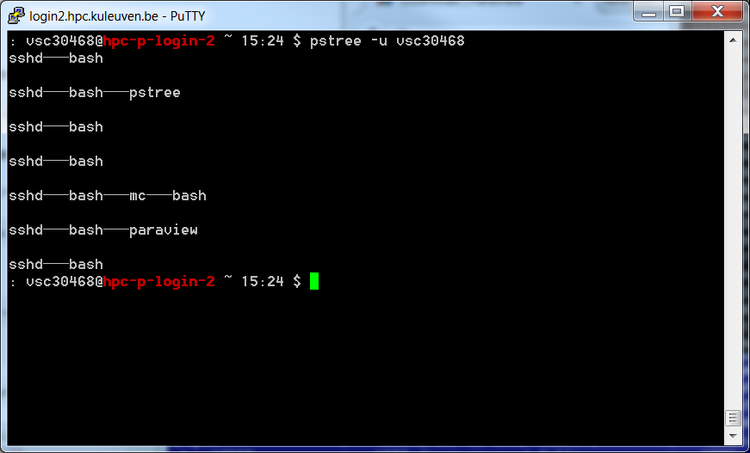
The shell
After login to the cluster or starting a job: a new shell is opened
Processes originating from each shell can be checked with pstree
pstree shows only processes on the current node (login1, or login2(3,4) or compute node)

Slide 54
Most popular shells
There are several types of shells for Linux.
Check it with $ echo $SHELL
Shell | Prompt | Name | Note
sh | $ | Bourne Shell | Default on some Unix systems
bash | $ | Bourne Again Shell | Enhanced replacement for the Bourne shell Default on most Linux and Mac OS X systems
csh | % | C Shell | Default on many BSD systems
tcsh | > | TC Shell | Enhanced replacement for the C shell
ksh | $ | Korn Shell | Default on AIX systems

Slide 55
Starting shells
In practice, users seldom need to start a shell manually. Whenever someone logs in, or opens a terminal, a shell is started automatically.
You can start a different shell, or another instance of the same shell. Because the shell is "just another" program, new shells can be launched from an existing shell.
The new shell is referred to as a subshell of the original shell. When the subshell is exited, control is returned to the original shell.
Subshell inherits all variables/context from the parent shell.
If you quit the subshell, its context will purge.
The apparent differences between the subshell and the parent shell are minimal, and care must be taken to keep track of which shell you are in.

Slide 56
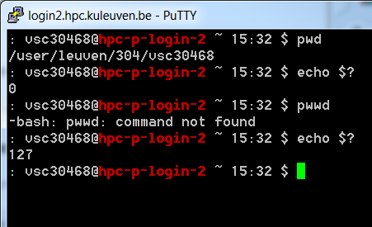
Return/Exit Code
Shell commands are CASE SENSITIVE!
Upon exiting, every command returns an integer to its parent called a return value.
The shell variable $? expands to the return value of previously executed command (e.g. 0 when success).
compare:
pwd
echo $?
with
pwwd (does not exist, mistyped)
echo $?

Slide 57
Escape character
When you create a file that contains space in it, e.g. touch ”my file” it is difficult to use it later
How to copy the file (cp source destination)
-> use escape character so that space is understood as a part of the file and not as a separator in comand syntax
cp my\ file myfile
Better avoid using “special” characters (", $, `, \, … ) in your filenames!

Slide 58
Auto-Completion
Have the shell automatically complete commands or file paths.
Activated using the <TAB> key on most systems
examples
$ whe<TAB>
$ whereis
$ ls -l /etc/en<TAB>
$ ls -l /etc/environment
When more than one match is found, the shell will display all matching results (use <TAB> twice)
$ ls -l /etc/host<TAB>

Slide 59
What was I doing???
Not to loose your job after closing your laptop:
Use desktop app
Use command line + tmux
Start session: $ tmux new –s test
Detach session: Ctrl+b+d (safe to go)
List session: $ tmux ls
Reattach session: $ tmux a -t test
Exit screen session (within tmux): $ exit

Slide 60
What was I doing???
Manage Windows and Session Tabs
Ctrl+B C | Create window
Ctrl+B W | List Windows
Ctrl+B N | Next window
Ctrl+B P | Previous window
Ctrl+B F | Find window
Ctrl+B , | Name window
Ctrl+B & | Kill window

Slide 61
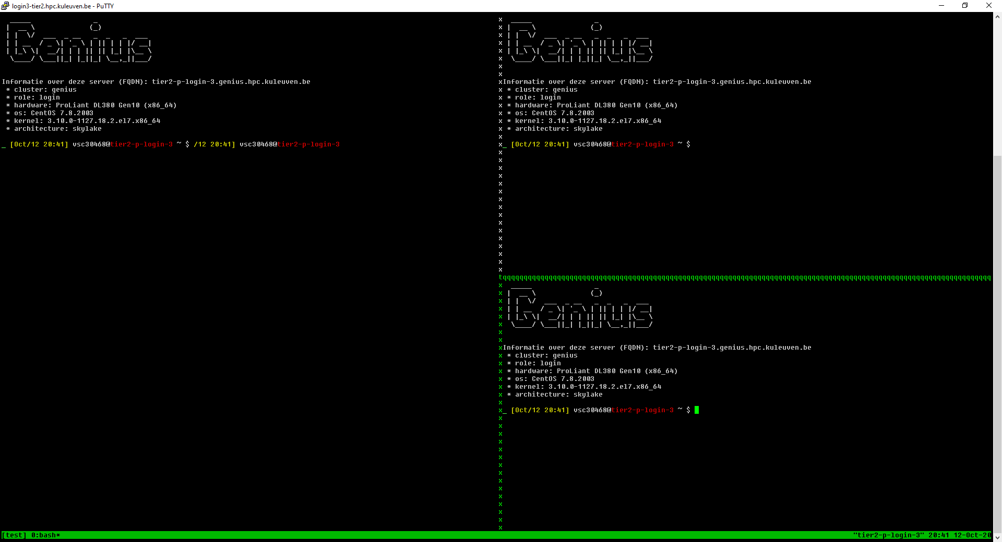
What was I doing???
Panes/splits
Ctrl+B % | Vertical split
Ctrl+B " | Horizontal split
Ctrl+B O | Swap panes
Ctrl+B Q | Show pane numbers
Ctrl+B X | Kill pane
Ctrl+B Arrow Keys | Move to pane

Slide 62
What was I doing???
Not to loose your job after closing your laptop:
Use desktop app
Use command line + screen
Start session: $ screen –S test
Detach session: Ctrl+a+d (safe to go)
List session: $ screen -ls
Reattach session: $ screen –r test
Exit screen session (within screen): $ exit

Slide 63
Screen
Create new window: ctrl-a c
Go to previous/next window: ctrl-a p/n
Go to window by number: ctrl-a <window-nr>
Show current windows, move: ctrl-a ", <window-nr>
Close window: ctrl-a K
Detach screen: ctrl-a d
List current screen sessions: $ screen -ls
Re-attach to session: $ screen -r <session-id>
Kill dead session: $ screen -wipe
Get help: ctrl-a ?
Monitor for activity: ctrl-a M (same to stop monitoring)
Monitor for inactivity: ctrl-a _ (same to stop monitoring)

Slide 64
Screen
Split screen horizontally: ctrl-a S
Split screen vertically: ctrl-a |
Go to next screen region: ctrl-a <tab>
Remove current region: ctrl-a X
Remove all but current region: ctrl-a Q
Enter copy mode: ctrl-a [
Paste: ctrl-a ]
Dump window contents to file: ctrl-a h
Enable logging: ctrl-a H
Useful .screenrc file that eliminates some of screen's nuisances:
# Turn off that annoying start up message
startup_message off
# Increase scroll back buffer to a more useful number of lines
defscrollback 10000

Slide 65
Screen - settings
In your .bashrc file
case ${TERM} in
xterm)
echo "Hello terminal!!!"
;;
screen)
echo "Hello screen!!!"
;;
esac

Slide 66
&
& is a command line operator that instructs the shell to start the specified program in the background.
This allows you to have more than one program running at the same time without having to start multiple terminal sessions.
Starting a process in background: add & at the end of your line: gedit & check with ps

Slide 67
Command history: Arrow Up
Previously executed commands can be recalled by using the Up Arrow key on the keyboard.
Most Linux distributions remember the last 500 commands by default.
Display commands that have recently been executed
The history command displays a user's command line history.
You can execute a previous command using ![NUM] where NUM is the line number in history you want to recall.
The history command itself comes at the end of the list. From the command line, the UP and DOWN arrow keys will quickly traverse this list up and down, while the LEFT and RIGHT arrow keys will move the cursor to allow the user to edit a given command.

Slide 68
Command history and sessions
Not only does the bash shell maintain a command history within a session, but the shell also preserves command histories between sessions. When the bash shell exits, it dumps the current command history into a file called .bash_history in a user's home directory. Upon startup, the shell initializes the command history from the contents of this file.
What repercussions does this have for multiple interactive shells (owned by the same user) running at the same time? Because the history is only saved to disk as the shell exits, commands executed in one bash process are not available in the command history of a simultaneously running bash process. Also, the last shell to exit will overwrite the histories of any shells that exited previously.

Slide 69
Command history: Ctrl +R
This key sequence mimics !cmd in spirit. Text typed after the CTRL+R key sequence is matched against previously typed commands, with the added advantage that matching command lines are viewed immediately as the text is typed.
You also have the opportunity to edit the recalled line (using the LEFT and RIGHT arrow keys, or other command line editing keystrokes) before executing the command.

Slide 70
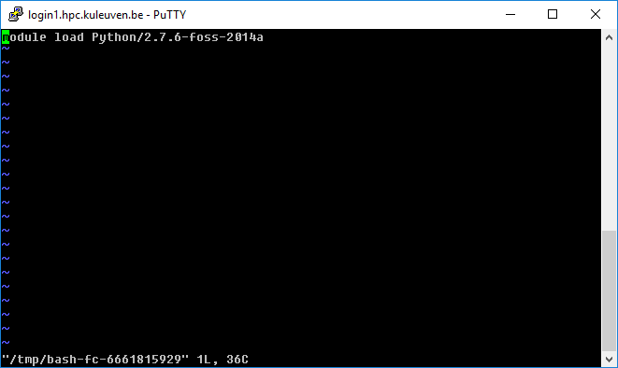
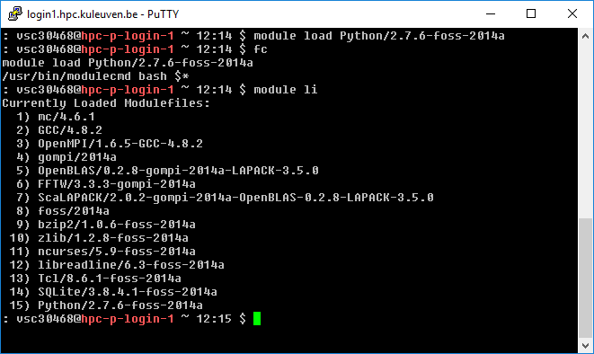
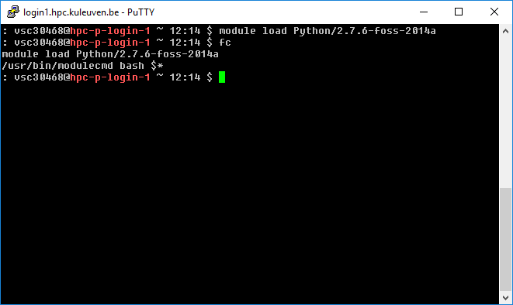
Command history: fc
The fc command allows users to "fix" the previously entered command, by opening up the user's default editor (vi by default) with the previously entered command as text. Upon exiting the editor (presumably after somehow editing the command), the new text will be immediately executed. For those proficient in quickly exiting an editor, the command comes in handy.

Slide 71
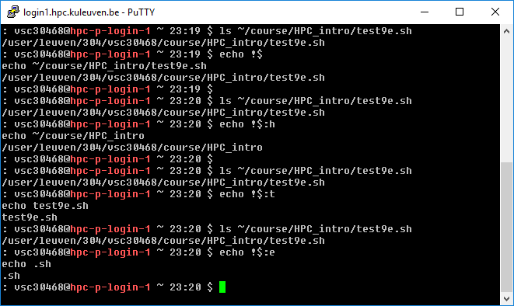
Command history
!$
Repeats the last argument of the last command.
:h
If you put it after a filename, it will change that filename to remove everything up to the folder.
:t
Leaves only
filename
:e
Leaves only
the extension

Slide 72
List Of Useful Bash Keyboard Shortcuts
ALT+B – Move backward.
ALT+F – Move forward.
ALT+T – Swaps the last two words.
ALT+U – Capitalize all characters in a word after the cursor.
ALT+L – Uncaptalize all characters in a word after the cursor.
ALT+. – Use the last word of the previous command.
!! – Repeats the last command.
ESC+t – Swaps the last two words.
CTRL+A – Quickly move to the beginning of line.
CTRL+B – To move backward one character.
CTRL+C – Stop the currently running command. (Putty and MFA firewall!)

Slide 73
List Of Useful Bash Keyboard Shortcuts
CTRL+D – Delete one character (backward).
CTRL+E – Move to the end of line.
CTRL+F – Move forward one character.
CTRL+H – Delete the characters before the cursor, same as BASKSPACE.
CTRL+J or CTRL+M – Same as ENTER/RETURN key.
CTRL+K – Delete all characters after the cursor.
CTRL+L – Clears the screen and redisplay the line.
CTRL+T – Swaps the last two characters.
CTRL+U – Delete all characters before the cursor (Kills backward from point to the beginning of line).
CTRL+W – Delete the words before the cursor.
CTRL+Y – Retrieves last item that you deleted or cut.
CTRL+Z – Stops the current command.

Slide 74
Hands-on 2

Slide 75
Shell

Slide 76
Environment variables
Shells let the user define variables. They can be reused in shell commands. By convention, shell variables have lower case names.
You can also define environment variables: variables that are also visible within scripts or executables called from the shell. By convention, environment variables have UPPER CASE names.
env Lists all exported environment variables and their value.

Slide 77
Environment variables
We can view the environment variables through set or env commands
The set command will display all the global functions written by the user
The env command displays only the variables and not the functions
We can reassign values for the variables either temporarily or permanently
Temporary
Type export varname=value at the command prompt
Permanent
Type export varname=value in .bashrc in your $VSC_HOME directory

Slide 78
Environment variables
Control the characteristics of the shell
View them with [set]env, or $VARIABLE
Set them with export
Change up your prompt! export PS1=“myNEWprompt: ”
Modify PATH:
$ unset PROMPT_COMMAND $ export PATH=${PATH}:/home/student/program
But these have to be declared every time you use your shell.
Solution: save them inside $VSC_HOME/.bashrc

Slide 79
Shell variables examples
Shell variables (bash)
projdir=$VSC_HOME/Downloads ls -la $projdir; cd $projdir
Environment variables (bash)
cd $HOME
export DOC=$HOME/Documents
echo $DOC
/user/leuven/30X/vsc30XXX/Documents
(displays the information if parameter is set)

Slide 80
Standard environment variables
Used by lots of applications! LD_LIBRARY_PATH Shared library search path
DISPLAY Screen id to display X (graphical) applications on.
EDITOR Default editor (vi, emacs...)
HOME Current user home directory
HOSTNAME Name of the local machine
MANPATH Manual page search path
PATH Command search path
PRINTER Default printer name
SHELL Current shell name
TERM Current terminal type
USER Current user name

Slide 81
PATH environment variables
e.g. which or whereis searches in that location
PATH Specifies the shell search order for commands
/home/acox/bin:/usr/local/bin:/usr/kerberos/bin:/usr/bin:/bin:/usr/X11R6/bin:/bin:/usr/bin
LD_LIBRARY_PATH Specifies the shared library (binary code libraries shared by applications, like the C library) search order for ld
/usr/local/lib:/usr/lib:/lib:/usr/X11R6/lib
MANPATH Specifies the search order for manual pages
/usr/local/man:/usr/share/man
e.g. whereis searches in that location
e.g. whereis searches in that location

Slide 82
Environment variables
Paths ($PATH, $LD_LIBRARY_PATH, $MAN_PATH, $CPATH, …) are modified when modules are loaded
After “module load” env will display a new value:
Example
$> echo $PATH
/user/leuven/30X/vsc30XXX/.tmux/bin:/apps/leuven/bin:/usr/local/bin:/usr/lpp/mmfs/bin:.:/usr/bin:/usr/sbin:/opt/moab/bin:/opt/mam/bin:/usr/local/bin:/usr/bin:/usr/local/sbin:/usr/sbin:/opt/ibutils/bin
$> module load R/4.2.1-foss-2021a
$> echo $PATH
/apps/leuven/rocky8/skylake/2021a/software/R/4.2.1-foss-2021a/bin:/user/leuven/30X/vsc30XXX/.tmux/bin:/apps/leuven/bin:/usr/local/bin:/usr/lpp/mmfs/bin:.:/usr/bin:/usr/sbin:/opt/moab/bin:/opt/mam/bin:/usr/local/sbin

Slide 83
Do-It-Yourself
$> module purge # start from clean slate $> env | grep PATH # default PATH(s) $> which python $> module load Python/3.9.5-GCCcore-10.3.0 $> env | grep PATH # PATH(s) are modified $> which python
Example
Questions
Which new directories are now added to $PATH?
Which python was originally used (after login)?
Which python is used after module load?

Slide 84
Environment variables
Optional Slide
vsc30XXX@hpc-p-login-1 ~ 16:23 $ module load intel/2021a
vsc30XXX@hpc-p-login-1 ~ 16:23 $ env|grep PATH
MANPATH=/apps/leuven/thinking/2014a/software/ifort/2013.5.192/man/en_US:/apps/leuven/thinking/2014a/software/ifort/2013.5.192/man:/apps/leuven/thinking/2014a/software/icc/2013.5.192/man/en_US:/apps/leuven/thinking/2014a/software/icc/2013.5.192/man:/usr/share/man
LIBRARY_PATH=/apps/leuven/thinking/2014a/software/imkl/11.1.1.106/mkl/lib/intel64:/apps/leuven/thinking/2014a/software/imkl/11.1.1.106/lib/intel64
FPATH=/apps/leuven/thinking/2014a/software/imkl/11.1.1.106/mkl/include/fftw:/apps/leuven/thinking/2014a/software/imkl/11.1.1.106/mkl/include
LD_LIBRARY_PATH=/apps/leuven/thinking/2014a/software/imkl/11.1.1.106/mkl/lib/intel64:/apps/leuven/thinking/2014a/software/imkl/11.1.1.106/lib/intel64:/apps/leuven/thinking/2014a/software/impi/4.1.3.045/lib64:/apps/leuven/thinking/2014a/software/impi/4.1.3.045/lib:/apps/leuven/thinking/2014a/software/ifort/2013.5.192/compiler/lib/intel64:/apps/leuven/thinking/2014a/software/ifort/2013.5.192/compiler/lib:/apps/leuven/thinking/2014a/software/icc/2013.5.192/compiler/lib/intel64:/apps/leuven/thinking/2014a/software/icc/2013.5.192/compiler/lib
CPATH=/apps/leuven/thinking/2014a/software/imkl/11.1.1.106/mkl/include/fftw:/apps/leuven/thinking/2014a/software/imkl/11.1.1.106/mkl/include
NLSPATH=/apps/leuven/thinking/2014a/software/imkl/11.1.1.106/idb/intel64/locale/%l_%t/%N:/apps/leuven/thinking/2014a/software/ifort/2013.5.192/idb/intel64/locale/%l_%t/%N:/apps/leuven/thinking/2014a/software/icc/2013.5.192/idb/intel64/locale/%l_%t/%N
PATH=/apps/leuven/thinking/2014a/software/imkl/11.1.1.106/mkl/bin/intel64:/apps/leuven/thinking/2014a/software/imkl/11.1.1.106/mkl/bin:/apps/leuven/thinking/2014a/software/imkl/11.1.1.106/bin:/apps/leuven/thinking/2014a/software/impi/4.1.3.045/bin64:/apps/leuven/thinking/2014a/software/impi/4.1.3.045/bin:/apps/leuven/thinking/2014a/software/ifort/2013.5.192/bin/intel64:/apps/leuven/thinking/2014a/software/ifort/2013.5.192/bin:/apps/leuven/thinking/2014a/software/icc/2013.5.192/bin/intel64:/apps/leuven/thinking/2014a/software/icc/2013.5.192/bin:/usr/lib64/qt-3.3/bin:/apps/leuven/icts/moab-8.1.2/bin/:/apps/leuven/bin:/usr/local/bin:/usr/lpp/mmfs/bin/:.:/usr/local/bin:/bin:/usr/bin:/usr/local/sbin:/usr/sbin:/sbin:/opt/ibutils/bin
MODULEPATH=/apps/leuven/thinking/2014a/modules/all:/apps/leuven/etc/modules/

Slide 85
Aliasing
Alias – Alternate name for a command(s)
You can be inventive with it, but be careful
If you log out from bash, your aliases will be purged!
To define an alias permanently, put it in your .bashrc
E.g. Image, your jobs always store the results in your scratch folder. So, you want an easy way to copy them to your data folder: alias backup=“cp –r $VSC_SCRATCH/results $VSC_DATA/backup”
To disable an alias, do: unalias backup

Slide 86
Alias and Unalias
alias newname=oldname
eg. alias copy=cp
Then we can use copy in the same way we use cp command
eg. copy file1 file2 //copies content of file1 to file2
To remove alias use unalias command
unalias copy
After this we cannot use copy to perform copying function

Slide 87
Alias
Shells let you define command aliases: shortcuts for commands you use very frequently.
Examples
alias la='ls -la' Useful to always run commands with default arguments.
alias rmi='rm -i' Useful to make rm always ask for confirmation.
alias data='cd /data/leuven/304/vsc30XXX' Useful to replace very long and frequent commands.
alias schck='. /home/mag/env/chck.sh' Useful to set an environment in a quick way (. is a shell command to execute the content of a shell script).

Slide 88
which command
Before you run a command, which tells you where it is found
which ls alias ls='ls --color=auto' /usr/bin/ls
which alias
/usr/bin/alias
which help
/usr/bin/which: no help in (/usr/local/bin:/usr/local/sbin:/usr/bin:/usr/sbin:/bin:/sbin:/home/mag/.local/bin:/home/mag/bin)

Slide 89
~/.bashrc file
~/.bashrc Shell script read each time a bash shell is started (login, or when the job starts on a compute node)
You can use this file to define
Your default environment variables (PATH, EDITOR...).
Your aliases.
Your prompt (see the bash manual for details).
A greeting message.
Do NOT put “module load” in your .bashrc. It creates conflicts

Slide 90
bash configuration Files
bash has two different login files.
.bashrc gets read when you open a local shell on a machine
.bash_profile only gets read if and only if you login from a remote machine. Note that .bash_profile itself reads in your .bashrc file as well.
If you want aliases to be executed regardless, then you should put them in the .bashrc file.
On the cluster please edit only .bashrc file – in case of problem we can always allow you access thanks to correct .bash_profile

Slide 91
~/.bash_profile
This is how your ~/.bash_profile looks like
Tip: never touch it
~/.bash_profile
# File: .bash_profile
# Get the aliases and functions
# Get whatever is in your
# .bashrc config file
if [ -f ~/.bashrc ]; then
. ~/.bashrc
fi

Slide 92
# File: .bashrc #
# Description: A default .bashrc
###Source global defs ###
if [ -f /etc/bashrc ]; then
. /etc/bashrc
fi
###set the prompt ###
# uncomment out only one
# this is hostname and time
PS1="\h-(\@): "
# this is hostname and
# history number
#PS1="\h-(\!)# "
# this is hostname and
# working directory
#PS1="\h-(\w)# "
# this is hostname and
# shortened working
# directory
#PS1="\h-(\W)# "
### path manipulation ###
# add ~/bin to the path,
# cwd as well
PATH="$PATH:$HOME/bin:./“
### env variables ###
# make sure that you
# change this to your
# username
MAIL="/afs/umbc.edu/users/u/s/username/Mail/inbox“
export PATH
unset USERNAME
### User-specific aliases
### and functions ###
alias rm="rm -i"

Slide 93
Flavours of Unix Shells
Two main flavours of Unix Shells
Bourne (or Standard Shell): sh, ksh, bash, zsh
Fast
$ for command prompt
C shell : csh, tcsh
easier for scripting
%, > for command prompt
To check shell:
% echo $SHELL (shell is a pre-defined variable -default)
% echo $shell (shell that is running)
To switch shell:
% exec <shellname> #e.g., % exec bash
$ shellname

Slide 94
What shell am I running?
Use the echo command E.g., to check your SHELL environment variable:
mag@localhost ~]$ tcsh
[mag@localhost ~]$ echo $SHELL
/bin/bash
[mag@localhost ~]$ echo $shell
/bin/tcsh
[mag@localhost ~]$
Issue a ps command to see all the processes in your current login session

Slide 95
Customization of a Session
Each shell supports some customization.
User prompt
Where to find mail
Shortcuts (alias)
The customization takes place in startup files
Startup files are read by the shell when it starts up
The Startup files can differ for different shell

Slide 96
Startup files
sh,ksh:
/etc/profile (out-of-the-box login shell settings) /etc/profile.local (addtnl. local system settings) ~/.profile (addtnl. user customized settings) ~/.kcshrc (non-login shell user customization)
bash: /etc/profile (out-of-the-box login shell settings) /etc/bash.bashrc (out-of-box non-login settings) /etc/bash.bashrc.local (global non-login settings)
~/.bash_profile (login shell user customization)
~/.bashrc (non-login shell user customization)
~/.bash_logout (user exits from interactive login shell)
csh/tcsh: /etc/login (out-of-the-box login shell settings) /etc/csh.login (non-login shell customizations) /etc/csh.login.local (global non-login settings)
~/.login: (login shell user customizations)
~/.cshrc: (non-login shell user customizations)
~/.cshrc.logout: (non-login shells at logout)
~/.logout: (read by login shells at logout)

Slide 97
Customization of a Session - prompt
LOGNAME: contains the user name
HOSTNAME: contains the computer name.
RANDOM: random number generator
SECONDS: seconds from the beginning of the execution
PS1: sequence of characters shown before the prompt
\t hour
\d date
\w current directory
\W last part of the current directory
\u user name
\$ prompt character

Slide 98
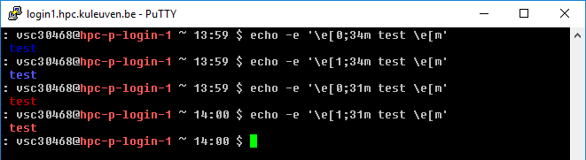
Customization of a Session
To add colors to the shell prompt check the following command syntax: $ echo ‘\e[x;ym test \e[m’ Where,
\e[ : Start color scheme.
x;y : Color pair to use (x;y)
test: to be printed
\e[m : Stop color scheme.
More info about colors e.g. at http://misc.flogisoft.com/bash/tip_colors_and_formatting
Color | Code
Black | 0;30
Blue | 0;34
Green | 0;32
Cyan | 0;36
Red | 0;31
Purple | 0;35
Brown | 0;33
Note: You need to replace digit 0 with 1 to get light color version.

Slide 99
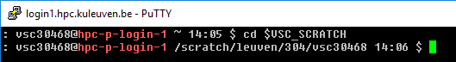
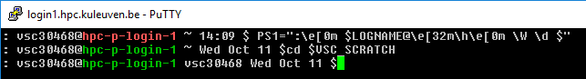
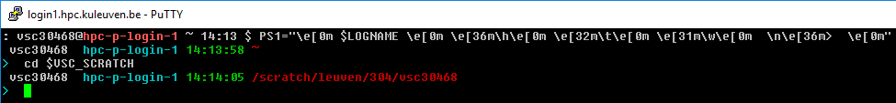
Customization of a Session
Standard PS1:
\u@\[\e[1;31m\]\h\[\e[0m\] \w `date +%H:%M`
Change PS1, e.g.
PS1=":\e[0m $LOGNAME@\e[32m\h\e[0m \W \d $“
Another example:
PS1="\e[0m $LOGNAME \e[0m \e[36m\h\e[0m \e[32m\t\e[0m \e[31m\w\e[0m \n\e[36m> \e[0m"

Slide 100
Environment Variables
Use the env command to see all environment variables
set/export to see all shell variables
Set or change environment variables from the command-line: new values last only for current login session.
sh/bash/ksh set: NEW_VARIABLE=newvalue append: OLD_VARIABLE=$OLD_VARIABLEnewvalue prepend: OLD_VARIABLE=newvalue$OLD_VARIABLE
add: OLD_VARIABLE=${OLD_VARIABLE}:newvalue
export OLD_VARIABLE
csh/tcsh set: set NEW_VAR=newvalue
append: set OLD_VAR=($OLD_VAR newvalue)
prepend: set OLD_VAR=(newvalue $OLD_VAR)
set: setenv OLD_VAR newvalue
append: setenv OLD_VAR ${OLD_VAR}newvalue
prepend: setenv OLD_VAR newvalue${OLD_VAR}
The order decides where system checks for command first (important if you have your own version and there is another vesion on the cluster)

Slide 101
Introduction to bash
The bash shell is one of the many shells that are available to you on the VSC nodes.
Almost any installation of Linux defaults to the bash shell.
bash is one of the many GNU.org (http://www.gnu.org) projects.
bash manuals:
A comprehensive online manual is provided at http://www.gnu.org/software/bash/manual/bashref.html
Aliases - http://www.gnu.org/software/bash/manual/bashref.html#Aliases
Controlling the Prompt - http://www.gnu.org/software/bash/manual/bashref.html#Controlling-the-Prompt

Slide 102
Universal customization
Universal .bashrc - written to run on all (relevant) clusters:
case ${VSC_INSTITUTE_CLUSTER} in
wice)
ulimit -c 500000
export LD_LIBRARY_PATH="${HOME}/lib:${LD_LIBRARY_PATH}"
export PATH="${HOME}/bin:${HOME}/sbin:${PATH}"
export EDITOR="/usr/bin/vim"
export PS1=': \u@\[\e[1;31m\]\h\[\e[0m\] \w `date +%H:%M` $'
source ${HOME}/.autoenv/activate.sh
;;
genius)
export EDITOR="/usr/bin/vim"
alias vim="vim -u .vimrc-simple“
export PS1=': \u@\[\e[1;34m\]\h\[\e[0m\] \w `date +%H:%M` $ '
;;
esac

Slide 103
Hands-on 3

Slide 104
Shell scripts

Slide 105
Using the Shell Command Line Interpreter or CLI
To understand scripts let's practice a bit with the CLI. At the shell prompt try:
# cd; echo “Hello, World” > test.txt; cp test.txt test.txt.bak; vi test.txt
The above is all on one line.
What happened?

Slide 106
Using the Shell In a file
Create a new file and place the some of commands in it:
$ cd $VSC_DATA
$ vim newscript.sh
echo “Hello world” > hello.txt
cp hello.txt hello.txt.bak
cat hello.txt hello.txt.bak > new.txt
cat new.txt

Slide 107
Using the Shell In a file
Now we can execute those commands in the order in which they appear in the file by doing this. There are 3 ways to execute a script:
$> bash newscript
$> sh newscript
$> . newscript
In a sub-shell
In the current shell

Slide 108
Using the Shell As a shell script
Now we can take the last step and start to create self-contained scripts that run on their own.
We'll need to do two things:
1. Specify the CLI to use, and
2. Make the script executable chmod +x <script_name>

Slide 109
The “Shebang”
To specify that a file is to become a shell script you specify the interpreter like this at the very start of the file:
#!/bin/bash
Shebang is a comment line, so practically not executed
Shebang starts with #!
Then, shebang gives the path to an executable that will interpret the script
E.g. other typical shebangs could be:
#!/bin/python
#!/bin/perl
#!/bin/csh

Slide 110
When Not to Use Scripts?
Resource-intensive tasks, especially where speed is a factor (sorting, hashing, etc.)‏
Procedures involving heavy-duty math operations, especially floating point arithmetic arbitrary precision calculations, or complex numbers
Cross-platform portability required
Complex applications, where structured programming is a necessity (need type-checking of variables, function prototypes, etc.)‏
Project consists of subcomponents with interlocking dependencies
Extensive file operations required (Bash is limited to serial file access, and that only in a particularly clumsy and inefficient line-by-line fashion)‏
Need native support for multi-dimensional arrays or data structures, such as linked lists or trees
Need to generate or manipulate graphics or GUIs
Need direct access to system hardware or port or socket I/O

Slide 111
What's Next?
Now let's create a very simple shell script. This will simply echo back what you enter on the command line:
#!/bin/bash
echo $1
Enter this in a file new.sh, then do:
# chmod 755 new.sh
To run the script do:
# ./new.sh text

Slide 112
Shell scripts
Shell scripts are “programs” that are completely uncompiled, but read and executed by the shell line by line.
Typically end in .sh
Must be executable with chmod
Start with a “shebang” – tells the shell what to use to interpret it. e.g.,
#! /bin/bash for a bash script.

Slide 113
Example: Slurm Job Script
Slurm scripts do not need to be executable – they are submitted to the queue and executed some other way.
Shebang
#!/bin/bash -l
#SBATCH --cluster=wice
#SBATCH --job-name="hello_world"
#SBATCH -N 1
#SBATCH --ntasks-per-node=72
#SBATCH -t 1:00:00
#SBATCH --mem-per-cpu=3400M
#SBATCH –A lp_hpcinfo
module load intel/2021a which icc
cd $SLURM_SUBMIT_DIR
cp /apps/leuven/training/HPC-intro/cpujob.pbs $VSC_SCRATCH
touch output.log
echo I am done
Resource List
Module load(s)
Move data
Execure commands

Slide 114
Hands-on 4

Slide 115
Application development

Slide 116
Installing applications – home linux
Automatic way: yum
Yum is an interactive, rpm based, package manager.
To check the package: yum search phrase
To install yum install package-name (root only!)
To check installed packages: yum list installed
Possibility to install downloaded rpm package: rpm –i package

Slide 117
Manual installations
Some applications provide binary files – ready to use after unpacking.
Check the system – different flavours and architectures!

Slide 118
Compatibility Statement
Definition of the OS version
Kernel version (i.e. kernel 4.18.0-477.10.1.el8_8.x86_64)
glibc version (i.e. glibc 2.28)
Determining the OS Version
Kernel version ($ uname –r -> 4.18.0-477.10.1.el8_8.x86_64)
System distribution ($ uname –a)
glibc version ($ ldd --version -> 2.28)
$ rpm -qa | grep libc -> glibc-2.28)
Determining the OS Flavour/release
$ cat /etc/*-release

Slide 119
Manual installations
Some simple programs will only require compiling (hello world example from HPC intro:
cp -r /apps/leuven/training/HPC_intro $VSC_HOME; cd HPC_intro
module load foss/2021a; mpicc helloworldmpi.c –o hello.exe
mpirun ./hello.exe
Lots of specific (less frequently used) applications will require the whole configuration (configure-make process) and installation process. Usually manual is provided with instructions (README.txt)

Slide 120
Compiling simple applications
The compiler used for all Linux systems is GCC http://gcc.gnu.org
To compile a single-file application, developed in C : gcc -o test test.c Will generate a test binary, from the test.c source file
For C++ : g++ -o test test.cc
The -Wall option enables more warnings To compile sources files to object files and link the application : gcc -c test1.c gcc -c test2.c gcc -o test test1.o test2.o gcc automatically calls the linker ld

Slide 121
make
The compilation process can be automated using GNU make tool: http://www.gnu.org/software/make/manual/
make reads a file called Makefile from the current directory, and executes the rules described in this file
Every rule has a target name, a colon, and a list of dependencies, and the list of commands to generate the target from the dependencies
When simply running make, the default target that is generated is “all”. A target is only re-generated if dependencies have changed
Every year, we offer make training (half a day). Check: https://www.vscentrum.be/training

Slide 122
make
Makefiles are nice, but they don't easily allow easy adaptation to the different build environment and different build options
More elaborated build systems have been developed Autotools (automake, autoconf), based on Makefiles and shell scripts. Even though they are old and a little bit difficult to understand, they are the most popular build system for free software packages. CMake, a newer, cleaner build system Sconcs and Waf, other build systems based on Python
The typical steps to compile a autotools based package are: ./configure (--prefix=/location-of-the-installation) make sudo make install (when admin rights necessary)
or
make install

Slide 123
Python and R packages installation

Slide 124
Installing your own packages using conda
Installing Miniconda
Download the Bash script that will install it from conda.io using, e.g., wget:
$ wget https://repo.continuum.io/miniconda/Miniconda3-latest-Linux-x86_64.sh
Once downloaded, run the installation script:
$ bash Miniconda3-latest-Linux-x86_64.sh -b -p $VSC_DATA/miniconda3
Optionally, you can add the path to the Miniconda installation to the PATH environment variable in your .bashrc file. This is convenient, but may lead to conflicts when working with the module system or OS, so make sure that you know what you are doing in either case.
The line to add to your .bashrc file would be:
export PATH="${VSC_DATA}/miniconda3/bin:${PATH}

Slide 125
Installing Python packages using conda
Creating an environment
First, ensure that the Miniconda installation is in your PATH environment variable. The following command should return the full path to the conda command:
$ which conda
If the result is blank, or reports that conda can not be found, modify the `PATH` environment variable appropriately by adding miniconda's bin directory to PATH.
Creating a new conda environment is straightforward:
$ conda create -n science numpy scipy matplotlib
This command creates a new conda environment called science, and installs a number of Python packages.
This will default to the latest Python 3 version, if you need a specific version, e.g., Python 2.7.x, this can be specified as follows:
$ conda create -n science python=2.7 numpy scipy matplotlib

Slide 126
Installing Python packages using conda
Working with the environment
To work with an environment, you have to activate it. This is done with, e.g.,
$ source activate science
Here, science is the name of the environment you want to work in.
Install an additional package
To install an additional package, e.g., `pandas`, first ensure that the environment you want to work in is activated.
$ source activate science
Next, install the package:
$ conda install pandas
Note that conda will take care of all dependencies, including non-Python libraries. This ensures that you work in a consistent environment.

Slide 127
Installing Python packages using conda
Updating/removing
Using conda, it is easy to keep your packages up-to-date. Updating a single package (and its dependencies) can be done using:
$ conda update pandas
Updating all packages in the environement is trivial:
$ conda update --all
Removing an installed package:
$ conda remove pandas
Deactivating an environment
To deactivate a conda environment, i.e., return the shell to its original state, use the following command
$ source deactivate

Slide 128
Installing Python packages - alternatives
Checking for installed packages
Pip utility will list all packages that are installed for the Python distribution you are using, including those installed by you, i.e., those in your PYTHONPATH environment variable.
Load the module for the Python version you wish to use, e.g.,: $ module load Python/2.7.14-foss-2021a
Run pip: $ pip freeze
Note that some packages, e.g., mpi4py, h5py, pytables, ..., are available through the module system, and have to be loaded separately. These packages will not be listed by pip unless you loaded the corresponding module.
If you have any packages installed in .local directory, it will always take priority on whatever the Python version used (conda, module, system). That can lead to strange problems, so please avoid using that location.

Slide 129
Installing Python packages - pip
Load the appropriate Python module, i.e., the one you want the python package to be available for: $ module load Python/3.9.5-GCCcore-10.3.0
Create a directory to hold the packages you install, the last three directory names are mandatory: $ mkdir -p "${VSC_DATA}/python_lib/lib/python3.9/site-packages/"
Add that directory to the PYTHONPATH environment variable for the current shell to do the installation: $ export PYTHONPATH="${VSC_DATA}/python_lib/lib/python3.9/site-packages/:${PYTHONPATH}"
Add the following to your .bashrc so that Python knows where to look next time you use it: export PYTHONPATH="${VSC_DATA}/python_lib/lib/python3.9/site-packages/:${PYTHONPATH}"
Install the package, using the prefix install option to specify the install path (this would install the sphinx package): $ pip install --user sphinx
or
$ pip install --install-option="--prefix=${VSC_DATA}/python_lib" sphinx

Slide 130
Installing Python packages – easy_install
Load the appropriate Python module, i.e., the one you want the python package to be available for: $ module load Python/3.9.5-GCCcore-10.3.0
Create a directory to hold the packages you install, the last three directory names are mandatory: $ mkdir -p "${VSC_DATA}/python_lib/lib/python3.9/site-packages/"
Add that directory to the PYTHONPATH environment variable for the current shell to do the installation: $ export PYTHONPATH="${VSC_DATA}/python_lib/lib/python3.9/site-packages/:${PYTHONPATH}"
Add the following to your .bashrc so that Python knows where to look next time you use it: export PYTHONPATH="${VSC_DATA}/python_lib/lib/python3.9/site-packages/:${PYTHONPATH}"
Install the package, using the prefix option to specify the install path (this would install the sphinx package): $ easy_install --prefix="${VSC_DATA}/python_lib" sphinx

Slide 131
Installing R packages using conda
Creating an environment
First, ensure that the Miniconda installation is in your PATH environment variable. The following command should return the full path to the conda command:
$ which conda
If the result is blank, or reports that conda can not be found, modify the `PATH` environment variable appropriately by adding miniconda's bin directory to PATH.
Creating a new conda environment is straightforward:
$ conda create -n science -c r r-essentials r-rodbc
This command creates a new conda environment called science, and installs essentials and required packages.
Each package separately in a new env – developpers do not care about versions!

Slide 132
Installing R packages using conda
Working with the environment
To work with an environment, you have to activate it. This is done with, e.g.,
$ source activate science
Here, science is the name of the environment you want to work in.
Install an additional package
To install an additional package, e.g., `r-ggplot2`, first ensure that the environment you want to work in is activated.
$ source activate science
Next, install the package:
$ conda install -c r r-ggplot2
Note that conda will take care of all independencies. This ensures that you work in a consistent environment.

Slide 133
Installing R packages using conda
Updating/removing
Using conda, it is easy to keep your packages up-to-date. Updating a single package (and its dependencies) can be done using:
$ conda update r-rodbc
Updating all packages in the environement is trivial:
$ conda update --all
Removing an installed package:
$ conda remove r-mass
Deactivating an environment
To deactivate a conda environment, i.e., return the shell to its original state, use the following command
$ source deactivate

Slide 134
Installing other R packages using conda
Installing CRAN package:
> install.packages('readr', repos='http://cran.us.r-project.org')
Alternative approach:
$ conda skeleton cran readr
$ conda build r-readr
$ conda install --use-local r-readr
Doing that for the first time you need to install conda-build before:
$ conda install conda-build
Some packages not available in r-essentials are still available on conda channels, in that case, it's simple:
$ conda config --add channels r; conda install r-readxl

Slide 135
Installing R packages – alternatives
Load the appropriate R module, i.e., the one you want the package to be available for: $ module load R/4.2.1-foss-2021a
start R and install the package from there:
> install.packages("DEoptim")
Alternatively you can download the desired package:
$ wget cran.r-project.org/src/contrib/Archive/DEoptim/DEoptim_2.0-0.tar.gz
And Install the package from the command line:
$ R CMD INSTALL DEoptim_2.2-3.tar.gz -l /$VSC_DATA/R/
These packages might depend on the specific R version, so you may need to reinstall them for the other version.

Slide 136
Where to find help
https://docs.vscentrum.be/compute/software/python_package_management.html
https://www.youtube.com/@vschpc/videos

Slide 137
Hands-on 5

Slide 138
Usefull link(s) – tips and tricks:
http://gjbex.github.io/training-material/LinuxTools/
bash
cdargs
grep
network
screen
ssh
tmux
top
Vim

Slide 139
VSC
Questions
Helpdesk: hpcinfo@kuleuven.be or https://admin.kuleuven.be/icts/HPCinfo_form/HPC-info-formulier
VSC web site: http://www.vscentrum.be/
VSC documentation: https://docs.vscentrum.be
VSC agenda: training sessions, events
Systems status page: http://status.vscentrum.be

Slide 140


Slide 141
VSC training
Infosessions:
Containers
Notebooks
Jupyterhub
Julia, the good, the bad, the ugly
Introductory
Intermediate
Advanced
Specialized track
Matlab (Supercalculator)
Matlab Programming
Linux for HPC
Linux scripting
Make intro
Linux tools
Linux
HPC intro
CMake intro
Version control with Git
Python introduction
Python: System programming
Scientific Python
Python for Software engineering
Python for data science
Python for machine learning
Python-on-GPUs
Python Dashboards
worker/atools
Scientific C
C++ for scientific computing
Workflows on HPC
Fortran for programmers
MLOps on HPC
C++ for software engineering
High Performance Python
Heterogeneous Programming with Kokkos
Debugging techniques
MPI
OpenMP
Code optimization
?
Deploying Large Language Models Locally
edX MOOC Fortran for Programmers (announced by e-mail)
edX Defensive programming and debugging
Stay up-to-date https://www.vscentrum.be/en/education-and-trainings

